Slide 1

Mini Project-II (ID201B) Even Semester Session 2024-25
Shooter
Nikhil Upadhyay 202410116100132
Nikita Agarwal 202410116100133
Nitin Negi 202410116100137
Poornima 202410116100142
Project Supervisor:
Dr.Vipin Kumar

Slide 2
CONTENT
01
Introduction to Shooter: A Python-Powered Game
02
Literature Review: Python in Game Development
03
Objective of the Shooter Project
04
Technology: Hardware & Software
Requirements
05
Modules: Core Game Components
06
Workflow: Development Process
Reports & Future Work
07
References
08

Slide 3

Introduction to Shooter: A Python-Powered Game
Welcome to the world of Shooter, a dynamic game developed using Python. Picture a fast-paced, top-down shooter where you pilot a spaceship, battling enemies. The game boasts an engaging gameplay loop that will challenge your skills to the limit. In this exploration, we’ll delve into the use of Python libraries, such as Pygame, and the exciting journey of creating this captivating game.

Slide 4

Literature Review: Python in Game Development
Python's role in indie game development is growing due to its user-friendly nature. Several studies emphasize its ease of use and rapid prototyping capabilities, perfect for quickly testing and iterating game ideas.
Pygame is a well-established Python library for creating games, offering a wide range of features and functionalities. However, it's important to understand its limitations and compare it to other frameworks like Unity, especially for 2D game development.
The open-source game development community has built a vast ecosystem of Python libraries and game engines, offering unique features and use cases.

Slide 5
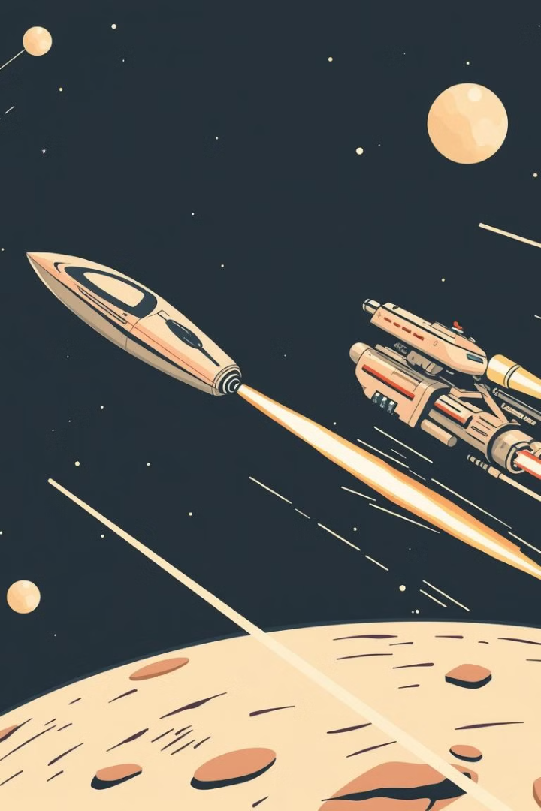
Objective of the Shooter Project
1
The primary goal is to create a functional and engaging shooter game using Python.
2
Implement core game mechanics like player movement, shooting, enemy AI, level design, and scoring.
3
Quantifiable goals: - Achieve a frame rate of at least 30 FPS. - Implement at least 3 different enemy types. - Design a minimum of 5 levels.

Slide 6
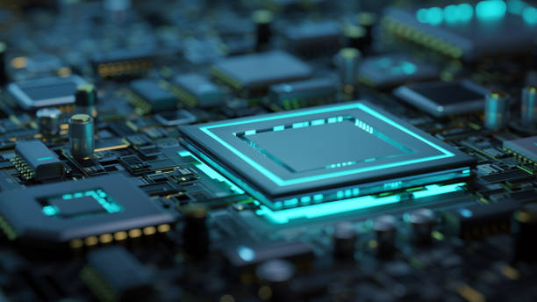

Technology: Hardware & Software Requirements
Hardware Requirements
Minimum System Requirements: Intel i5 or equivalent, 8GB RAM, 256GB SSD.
Development Environment: Game runs locally, no server required.
Client Compatibility: Windows, macOS, Linux.
Software Requirements
Programming Language: Python 3.x
Main Framework/Library: Pygame
Development Environment: VS Code with Python extension

Slide 7
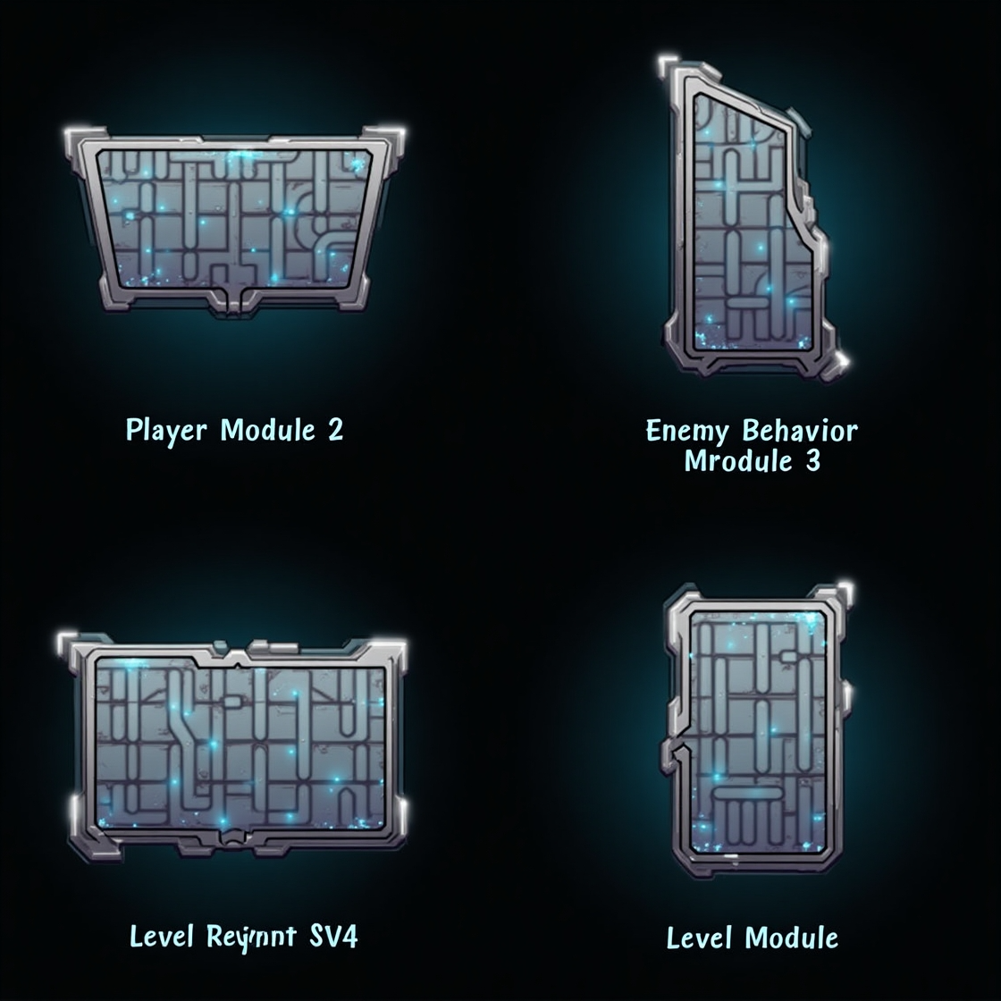
Modules: Core Game Components
Player Module
Enemy Behavior Module
Handles player input, movement, shooting, and health. Includes classes like Player, Weapon, and Projectile.
Enemy Behavior Module covers movement patterns, AI logic, and health system for various enemy types in the game.
EnemyAttack Module
Level Module
Controls enemy attacks, including shooting mechanisms, collision handling, and attack frequency/difficulty scaling.
Loads and manages game levels, including enemy spawns and environment. Level design uses data structures like 2D arrays.

Slide 8
Workflow: Development Process
Design
1
Define game mechanics, story (if any), and overall structure.
2
Implementation
Code core modules (player, enemy, level).
Testing
3
Unit testing, integration testing, and playtesting.
4
Iteration
Refine the game based on feedback and testing results.
Deployment
5
Package the game for distribution (if applicable).

Slide 9
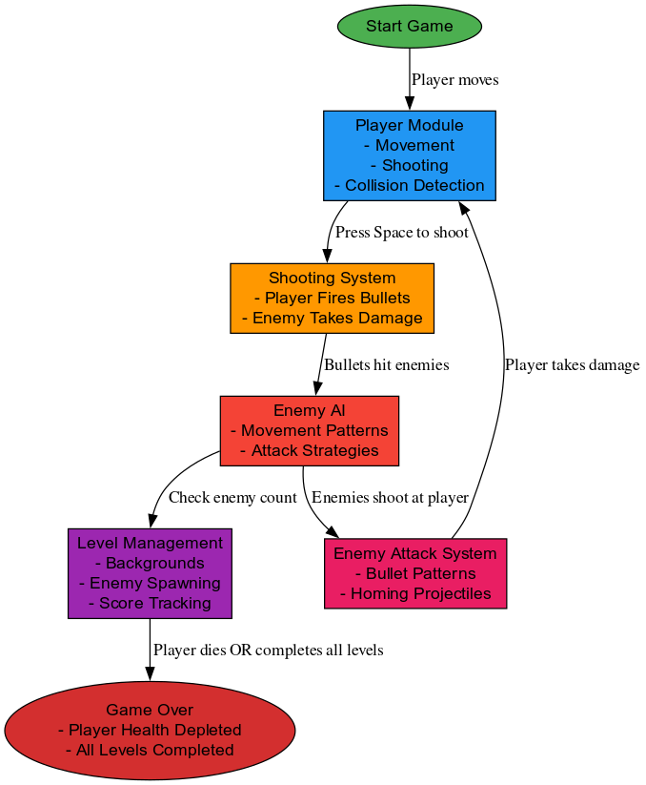
Workflow

Slide 10



Reports & Future Work
Reports
Future Work
Regular progress reports will be generated, summarizing completed tasks, challenges faced, and planned activities.
Future work includes adding new levels, enemies, weapons, and game modes. We'll explore performance and graphics improvements and consider porting the game to other platforms.

Slide 11
References
https://www.pygame.org/docs
https://gamedevelopment.tutsplus.com/articles/understanding-steering-behaviors-path-following--gamedev-4128
https://docs.unity3d.com
https://www.unrealengine.com/en-US
https://realpython.com/python-game-development
https://www.geeksforgeeks.org/python-game-development-creating-a-shooting-game
https://www.gamedeveloper.com/programming/behavior-trees-for-ai-how-they-work

